Slide 1
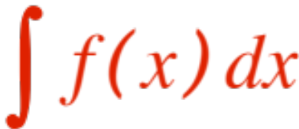
COMPUTING ANTI-DERIVATIVES
(Integration by PARTS )
The computation of anti-derivatives is just an in-tellectual challenge, we know how to take deriv-atives, but …
can we invert the process? We call this
Computing the indefinite integral .
In the last presentation we have seen a few
indefinite integrals (we called them bricks), but they did not include the anti-derivative of many functions! We are going to try and do better !

Slide 2
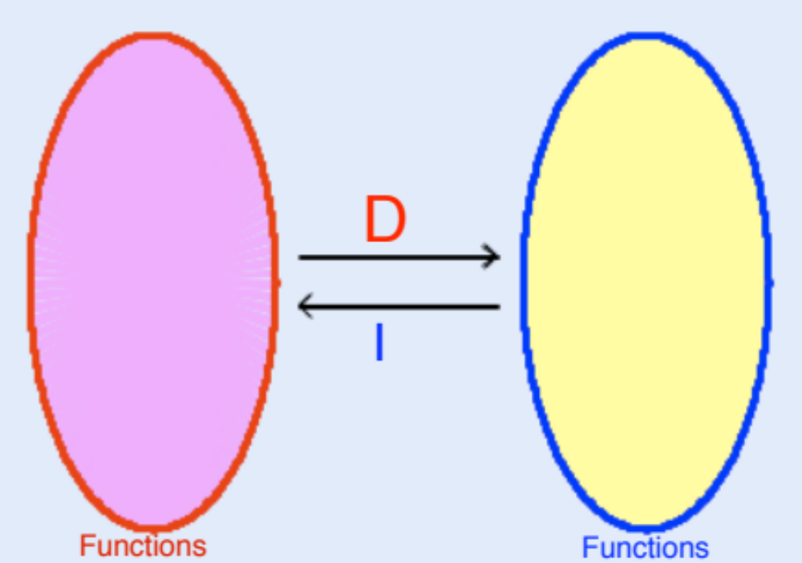
It pays off to look at differentiation and integration as inverse processes, that is, if we apply each in order we end up (essentially) where we started.
First D then I gives us “where we started + C”

Slide 3
First I then D gives us “where we started.”
This very simple observation is going to give us a fair amount of power, because we know how D works, and we can essentially take advantage of “undoing” it ! Here we go.

Slide 4



We know how D works on products (the product rule.) It says
Apply to both sides (remember that
where you started (never mind C !). We get
Since, luckily, the process is additive, we get (replacing the symbol with )
which we rewrite as

Slide 5
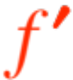
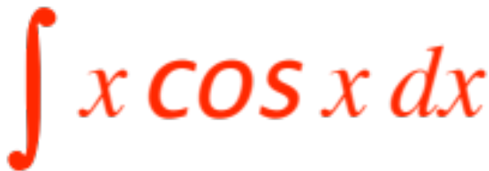
Now what? Well, in several appropriate circum-stances, if one chooses judiciously, the indef-inite integral one gets on the right-hand side is easier to compute than the left-hand side!
Here is an example: you have to compute
Choose
whence

Slide 6
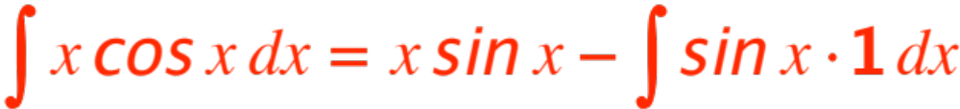
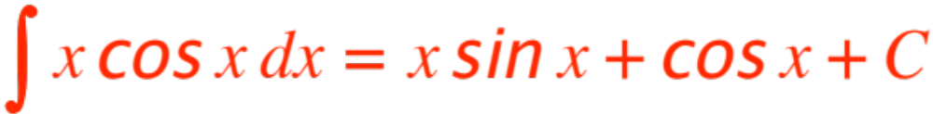

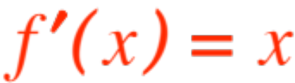
We get
Therefore
(check it out, take the derivative !)
If you choose the “unwise” , you end up with a worse integral than you started. Try
Unfortunately I cannot tell you what appropriate circumstances means, nor what is the judicious choice of , you just have to learn by experi-ence! There is a mnemonic help I can share:

Slide 7
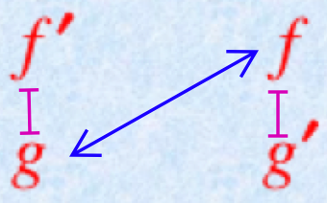
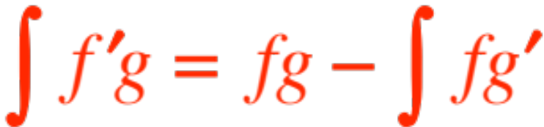
Once I have decided (rightly or wrongly !) what
Is, I make myself this little figure
and write
Your textbook delays this method to much later, p. 488, because it is most useful for integrating transcendental (exponents, logarithms) functions.

